Slide 1
PENTA CANCER DETECTION SYSTEM USING
DEEP LEARNING
VIBHA TI 2017103608
YUVASHREE N 2017103615
SHREENIDHI S 2017103620
under the guidance of
Dr. A. P. SHANTHI

Slide 2
CONTENTS
Introduction
Literature Survey
Overall Objectives
Overall Architecture
Detailed Module Design
Implementation details and Result Snapshots
Metrics for Evaluation
Validation and Test Cases
References

Slide 3
INTRODUCTION
Early detection of cancer is the top priority for saving the lives of many. Typically, visual examination and manual techniques are used for these types of a cancer diagnosis.
This manual interpretation of medical images demands high time consumption and is highly prone to mistakes.
Thus in this project we apply VGG16 deep learning architecture to classify between the different types of cancer and detect its presence without the need of a number of consultations from different doctors.
This leads to earlier prediction of the presence of the disease and allows us to take prior actions immediately to avoid further consequences in an effective and cheap manner avoiding human error rate.
In this project five different types of cancer such as lung cancer, brain tumour, cervical cancer, thyroid cancer and breast cancer are determined.
A web application will be developed as an hospital application where an input CT or MRI image will be given to predict which type of cancer.

Slide 4
LITERATURE SURVEY
TITLE OF THE PAPER | AUTHOR NAME | METHODOLOGY/ ALGORITHM | ISSUES/GAPS | IDEAS FOR ADOPTION
Robust Collaborative Clustering of Subjects and Radiomic Features for Cancer Prognosis[2020] | Hangfan Liu, Hongming Li, Mohamad Habes, Yuemeng Li, Pamela Boimel, James Janopaul-Naylor, Ying Xiao, Edgar Ben-Josef, and Yong Fan, Senior Member, IEEE | Their method is built upon matrix tri-factorization enhanced by adaptive sparsity regularization for simultaneous feature dimension. | Only one type of cancer is predicted. | Highly automatic and objective model named robust collaborative clustering methods and radiomic features for cancer detection.
Age-specific experimental and computational calibration of thyroid in vivo monitoring[2019] | T. Beaumont1,*,P. Onoma1, M. Rimlinger1, D. Broggio1, P. Caldeira Ideias2 and D.Franck3 1,*Institut de Radioprotection et de Sûreté Nucléaire (IRSN), PSE-SANTE/SDOS/LEDI, Fontenay-aux-Roses, France | Monte-Carlo calculation | Lesser accuracy. | The obtained efficiency curves are consistent and show that the relative difference in efficiency between the adult and the children case are energy dependent and feasible to implement.

Slide 5
TITLE OF THE PAPER | AUTHOR NAME | METHODOLOGY/ ALGORITHM | ISSUES/GAPS | IDEAS FOR ADOPTION
Ultra-Wideband, Stable Normal and Cancer Skin Tissue Phantoms for Millimeter-Wave Skin Cancer Imaging IEEE Transactions on Biomedical Engineering.[2018] | Amir Mirbeik-Sabzevari, Student Member, IEEE, Negar Tavassolian, Senior Member, IEEE. | Wave skin cancer detection methods | Lesser accuracy. | Measured permittivity results show excellent match with ex-vivo, fresh skin (both normal and malignant) permittivities determined in our prior work over the entire frequency range, which can be adopted.
Deeply-Supervised Networks with Threshold Loss for Cancer Detection in Automated Breast Ultrasound[2018] | Yi Wang, Na Wang, Min Xu, Junxiong Yu, Chenchen Qin, Xiao Luo, Xin Yang, Tianfu Wang, Anhua Li, and Dong Ni* | 3D convolutional network | Very expensive. | Effective cancer detection scheme for breast examination.

Slide 6
TITLE OF THE PAPER | AUTHOR NAME | METHODOLOGY/ ALGORITHM | ISSUES/GAPS | IDEAS FOR ADOPTION
Comparison of a Standard Resolution PET-CT Scanner With an HRRT Brain Scanner for Imaging Small Tumors Within the Head. IEEE Transactions on radiation and plasma medical sciences, vol. 3, no. 4, july 2019 | Jose M. Anton-Rodriguez , Peter Julyan, Ibrahim Djoukhadar, David Russell, D. Gareth Evans, Alan Jackson, and Julian C. Matthews | PET-CT scanner (Siemens Biograph TruePoint TrueV) | Lesser accuracy. | Standard Resolution PET-CT Scanner With an HRRT Brain Scanner for Imaging Small Tumors.
Deep Recurrent Neural Networks for Prostate Cancer Detection: Analysis of Temporal Enhanced Ultrasound IEEE Transactions on Medical Imaging [2016] | Shekoofeh Azizi, Sharareh Bayat, Pingkun Yan, Amir Tahmasebi, Jin Tae Kwak, Sheng Xu, Baris Turkbey, Peter Choyke, Peter Pinto, Bradford Wood, Parvin Mousavi*, Purang Abolmaesumi | Deep Recurrent Neural Networks (RNN) | Very expensive and the manufacturing according to our need takes time. | Improved cancer detection.

Slide 7
OVERALL OBJECTIVE
To determine the presence of cancer at an early stage
Use CT images or x-ray images for the detection of cancer.
To reduce the time required to detect the presence of cancer.
To determine the cheap way to predict the cancer presence.
To predict five different types of cancer.

Slide 8
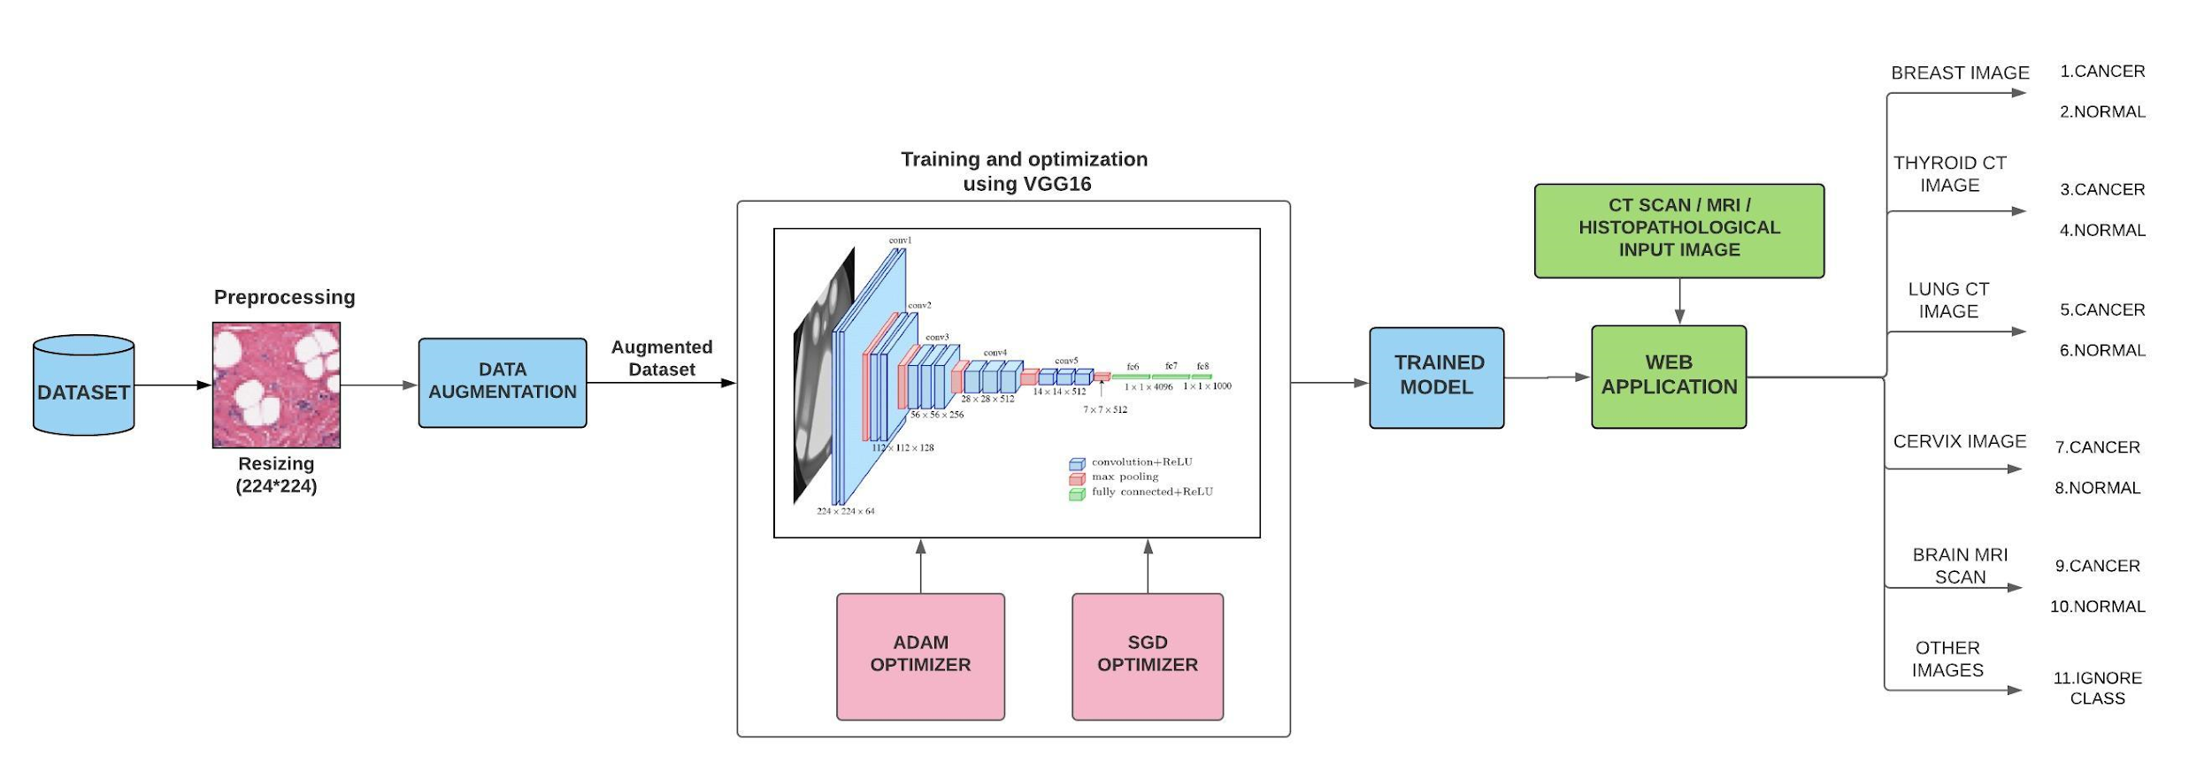
OVERALL ARCHITECTURE

Slide 9
DETAILED MODULED DESIGN TYPES OF MODULES
Dataset Preprocessing
Dataset Augmentation
Penta cancer Prediction Using The Architecture
Web Application Development

Slide 10
DATASET PREPROCESSING
In this project the preprocessing data module is used to resize the images.
In deep Learning module the quality of the training data determines the quality of your model.
The data you will encounter in practice will be not clean in most cases. It means the data will contain non-uniform data formats, missing values, outliers, and features with very different ranges.
The data would not be ready to be used as training data for your model.
For those reason, the data must be preprocessed in various ways.

Slide 11
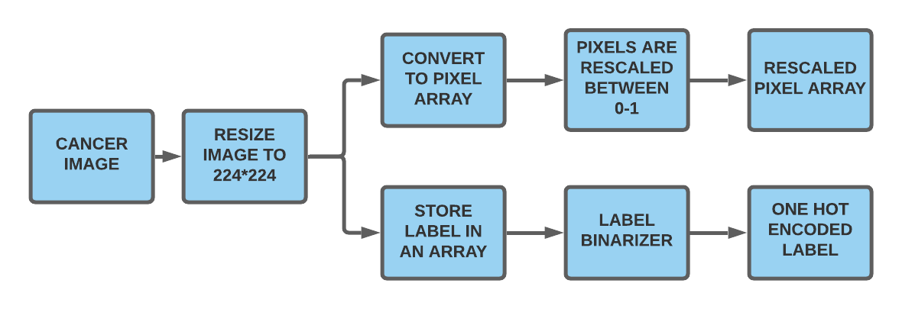

Slide 12
ALGORITHM
Resize the input image to 224*224 dimension
Each image converted into pixel array which is stored in data array
Labels for the images are stored in label array
The pixels of the each image is rescaled between 0-1 by dividing by 255
Dataset is split into training set(75%) and testing set(25%)
Label binarizer is used to convert the labels to binary form

Slide 13
DATA AUGMENTATION
The performance of deep learning neural networks often improves with the amount of data available.
Data augmentation is a technique to artificially create new training data from existing training data. This is done by applying domain-specific techniques to examples from the training data that create new and different training examples.
Image data augmentation is perhaps the most well-known type of data augmentation and involves creating transformed versions of images in the training dataset that belong to the same class as the original image.

Slide 14
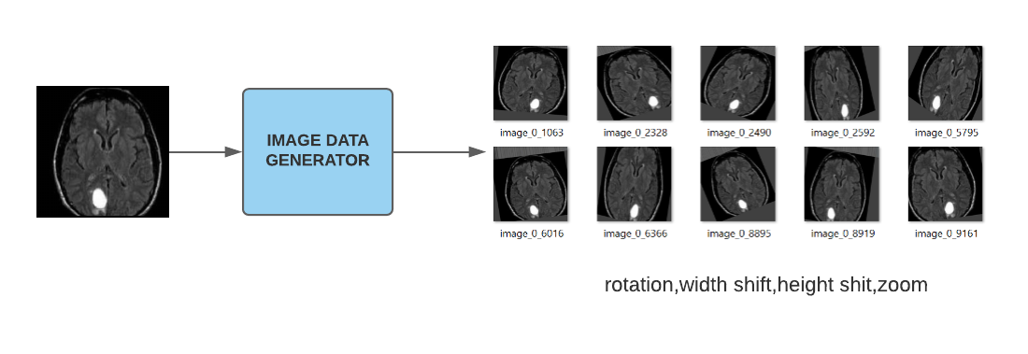

Slide 15
ALGORITHM
ImageDataGenerator class from keras is used.
Rotation range is set to 30°
Width_shift_range is set to 10%
Height_shift_range is set to 10%
Zoom_range is set between 80%-120%
Shear_range is set to 20%
Horizontal flip is set as true

Slide 16
PENTA CANCER PREDICTION
In order to predict the presence of the type of cancer from the five different types, we will be training with a VGG16 algorithm which provides accuracy in classification of images.
The VGG16 architecture is an innovative object-recognition model that supports up to 16 layers. The architecture also outperforms baselines on many tasks and datasets outside of ImageNet.
The convolutional layers in the VGG16 architecture use a very small receptive field (3x3, the smallest possible size that still captures left/right and up/down).
The architecture also makes use of residual networks producing very high accuracy.

Slide 17
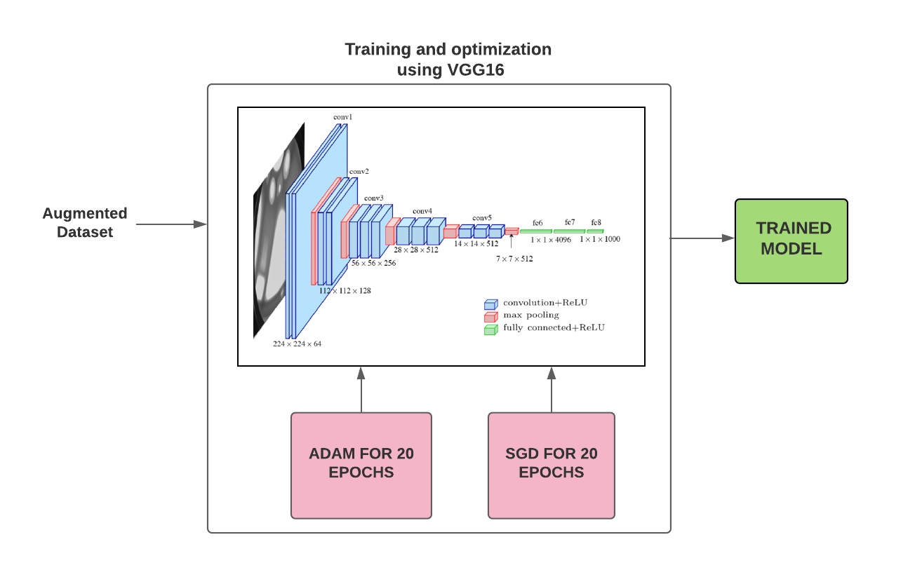

Slide 18
ALGORITHM
VGG sequential model is built with keras.model library
The input image size of vgg16 is set to is 224*224*3 which is its default size.
A flatten layer is added to flatten the feature map into single dimensional vector
A fully connected layer with ReLU activation is added on top of it
Another dense layer with softmax activation function is added to complete the architecture
SGD and Adam optimizers are used for loss minimization.
For the first 20 epochs Adam optimizer is used and for the next 20 epochs SGD optimizer is used.
The model is trained using the train set
Model is validated using the test set
Classification report is printed
Trained model is saved

Slide 19
WEB APPLICATION DEVELOPMENT
A web application using a javascript framework reactJS is developed.
An application is developed in such a way that an input image of the cancer image will be given and an output is obtained.
A database will be managed using which the prediction process happens in the backend and the result is been fetched through the web application

Slide 20
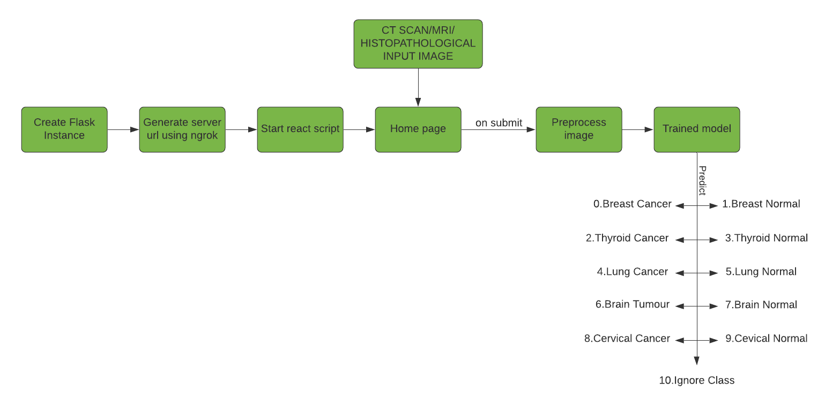

Slide 21
ALGORITHM
Frontend is developed using ReactJS
Flask is used to integrate the trained model with the application.
The fetched input is passed through the model and analyzed.
The model predicts the input whether it is cancer or not.

Slide 22
IMPLEMENTATION DETAILS AND RESULT SNAPSHOTS

Slide 23
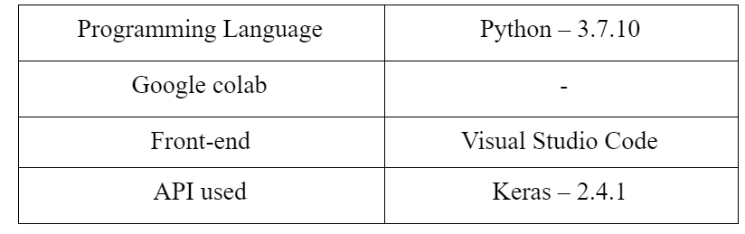
SOFTWARE REQUIREMENT

Slide 24
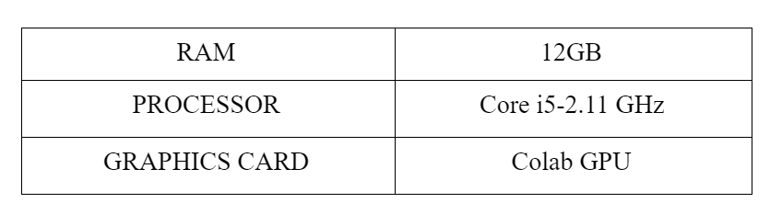
HARDWARE REQUIREMENTS

Slide 25
WORKING
In this project, we are going to determine presence of lung cancer, skin cancer,brain tumor,cervical cancer or thyroid cancer. We determine the presence of cancer by the CT, histopathological and MRI images.
Initially, the dataset is collected where we will be collecting dataset such as CT, histopathological and MRI images which are used by the laborites to analyse the presence of cancer from various resources through internet.
Splitting those datasets into different categories that is we will be splitting the dataset into training and testing dataset. The dataset is used for training the module whereas testing dataset is used to evaluate the model when it is been completely ready.

Slide 26
Training dataset first undergoes the process called dataset augmentation, where the dataset is multiplied into many datasets then it will undergo the process called preprocessing, which is to make all sizes into single size.
We train that datasets by extracting the features using VGG16 algorithms. It undergoes a process called optimization which will optimize the model and loss minimization which will reduce the noises generated during training.
Then, the resulting sequential model object is serialized and saved.
A web application using a javascript framework reactJS will be developed where an input image will be given to predict which type of cancer. Thus, this method provides an effective and cheap method to determine the presence of lung cancer, skin cancer or brain tumor.

Slide 27
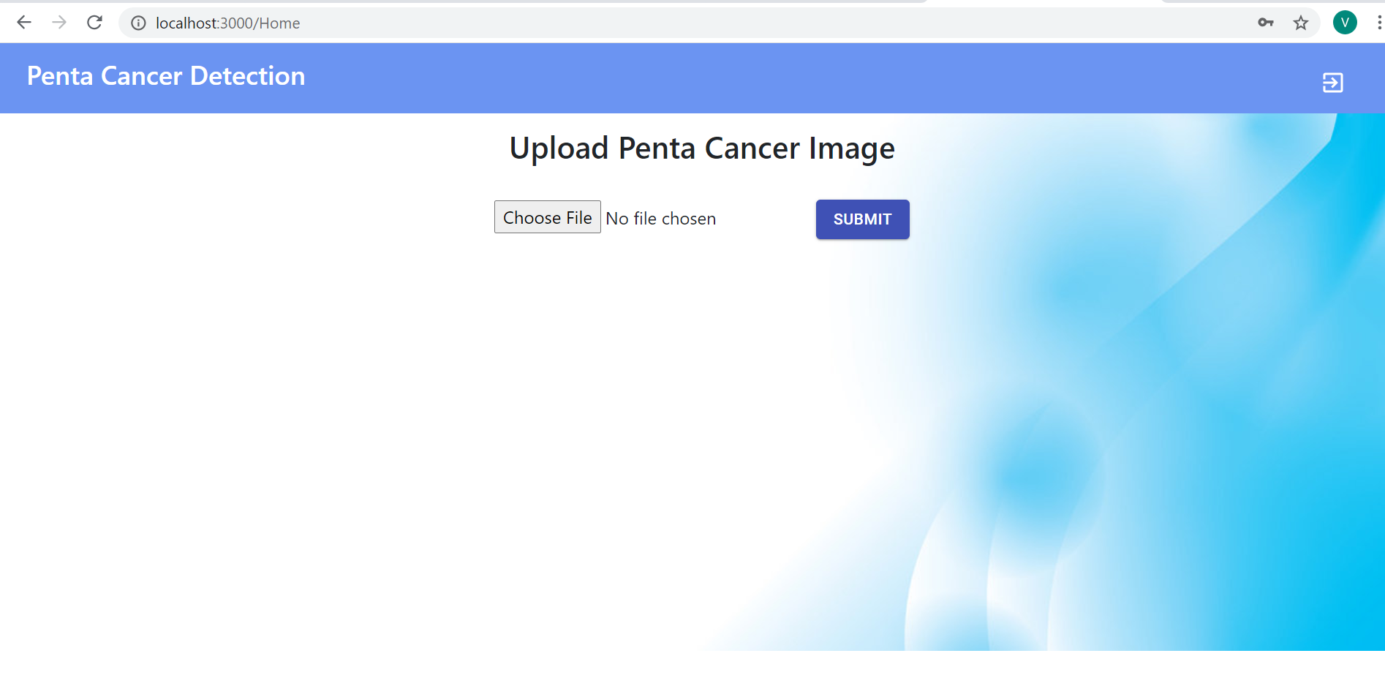
PENTA CANCER DETECTION WEBSITE

Slide 28
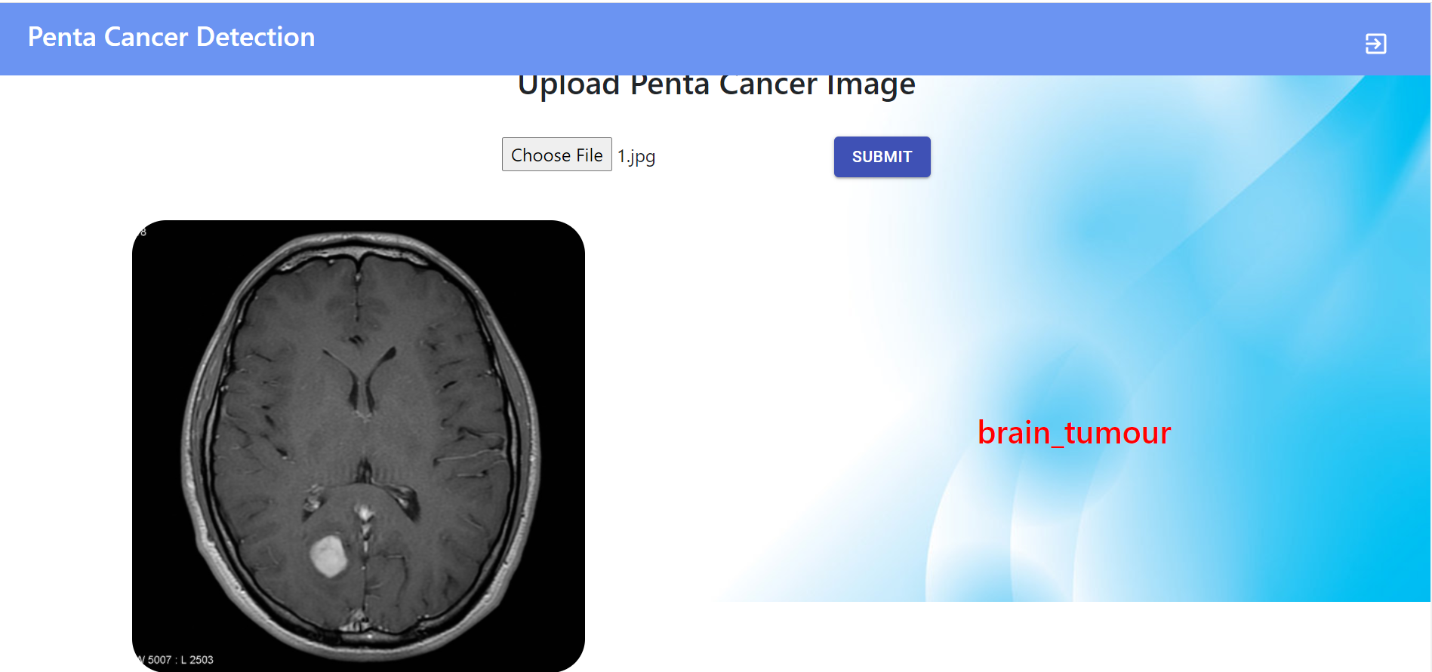
CANCER DETECTION

Slide 29
METRICS FOR EVALUATION
Accuracy=No of correctly classified images/Total no of images

Slide 30

CONFUSION MATRIX & REPORT
Predicted
Actual

Slide 31
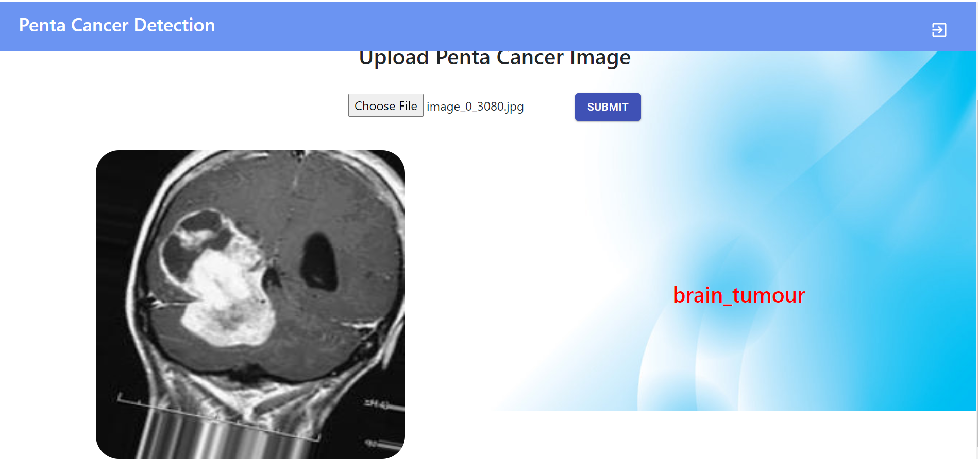
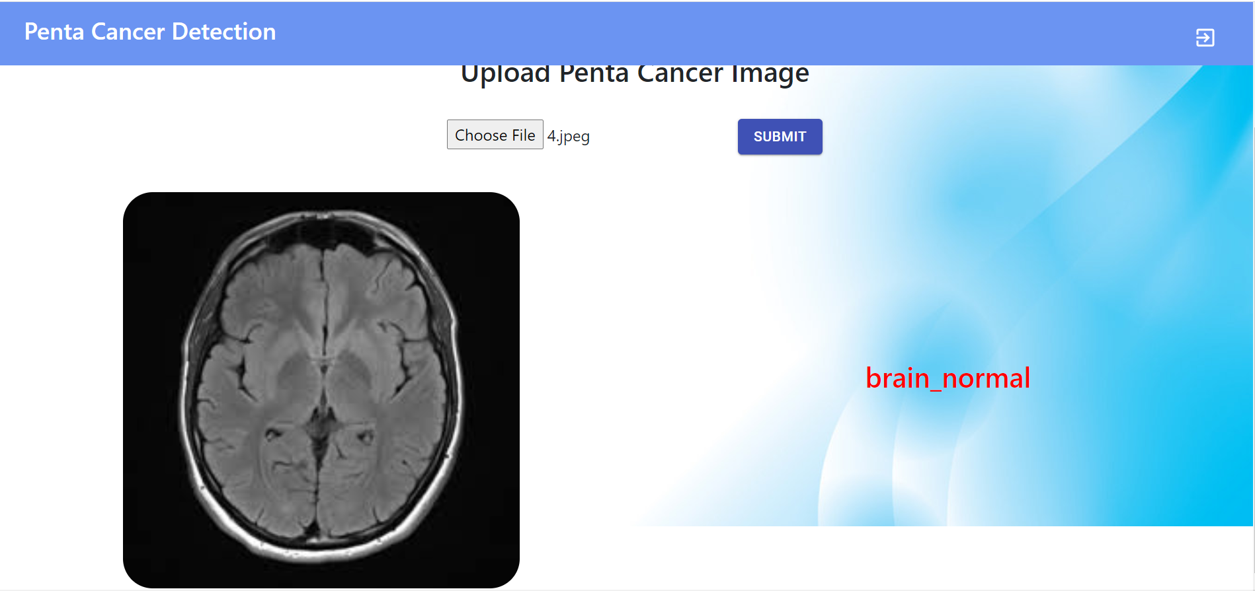
VALIDATION AND TEST CASES
Brain
True Positive True Negative

Slide 32
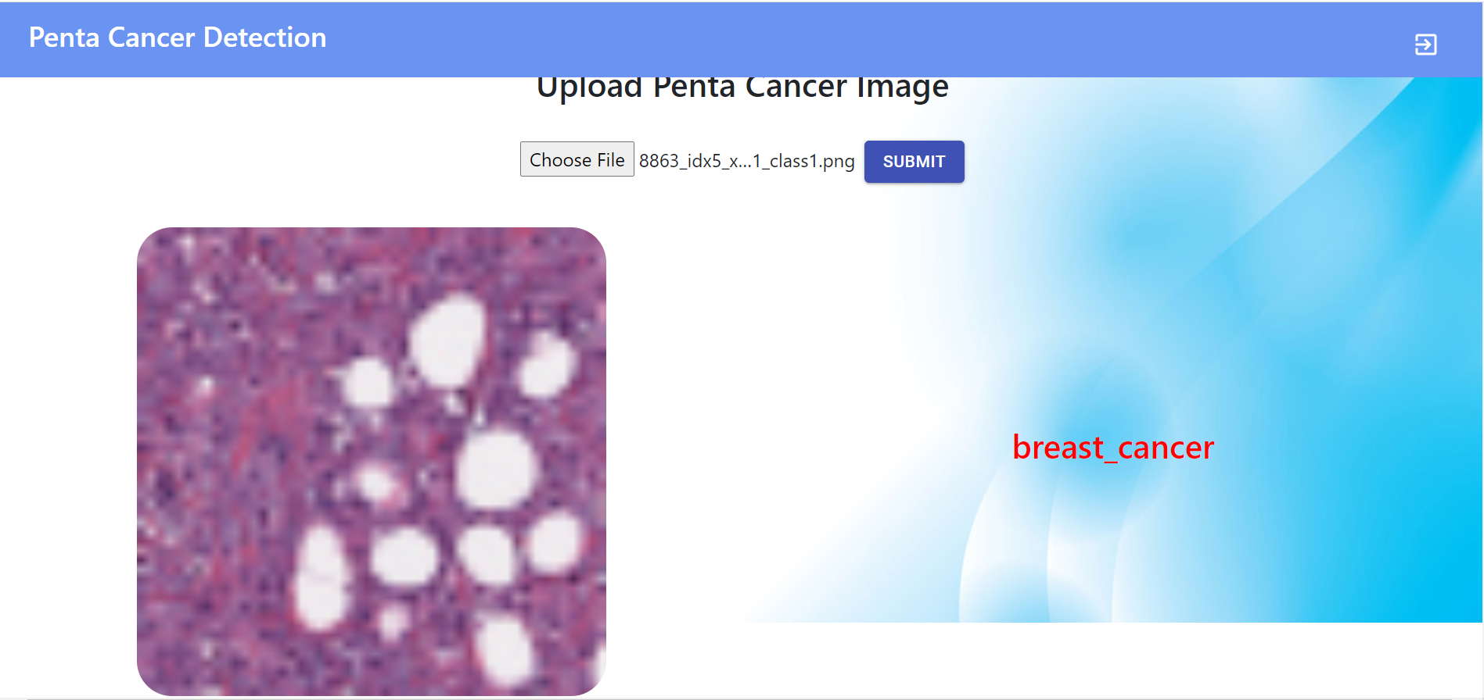
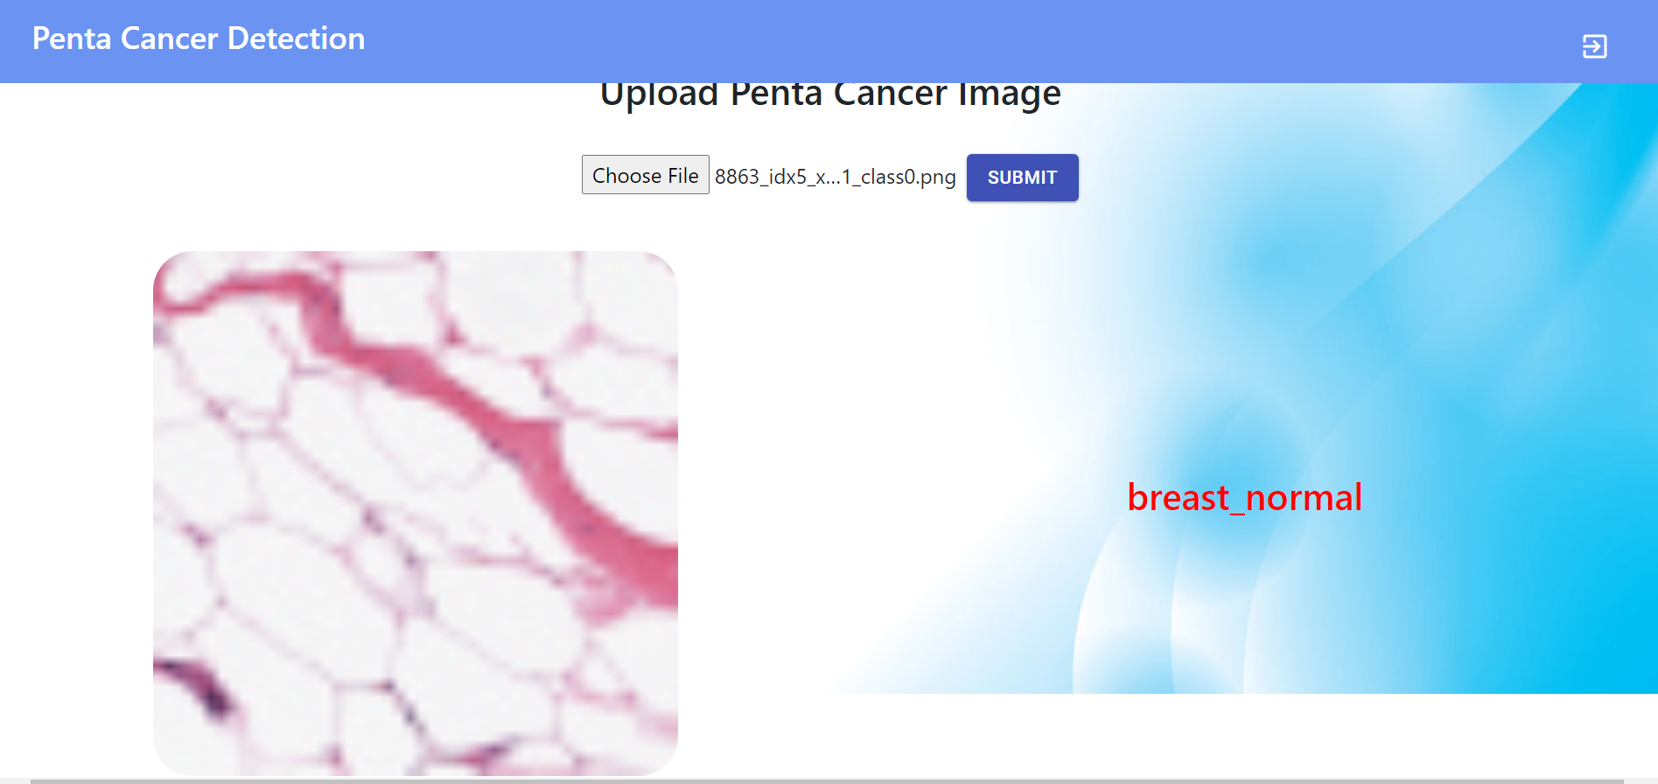
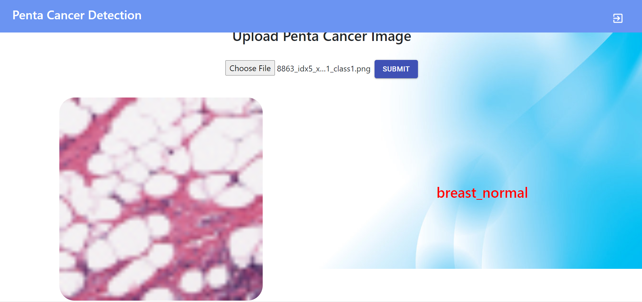
Breast
True positive True Negative
False Negative

Slide 33
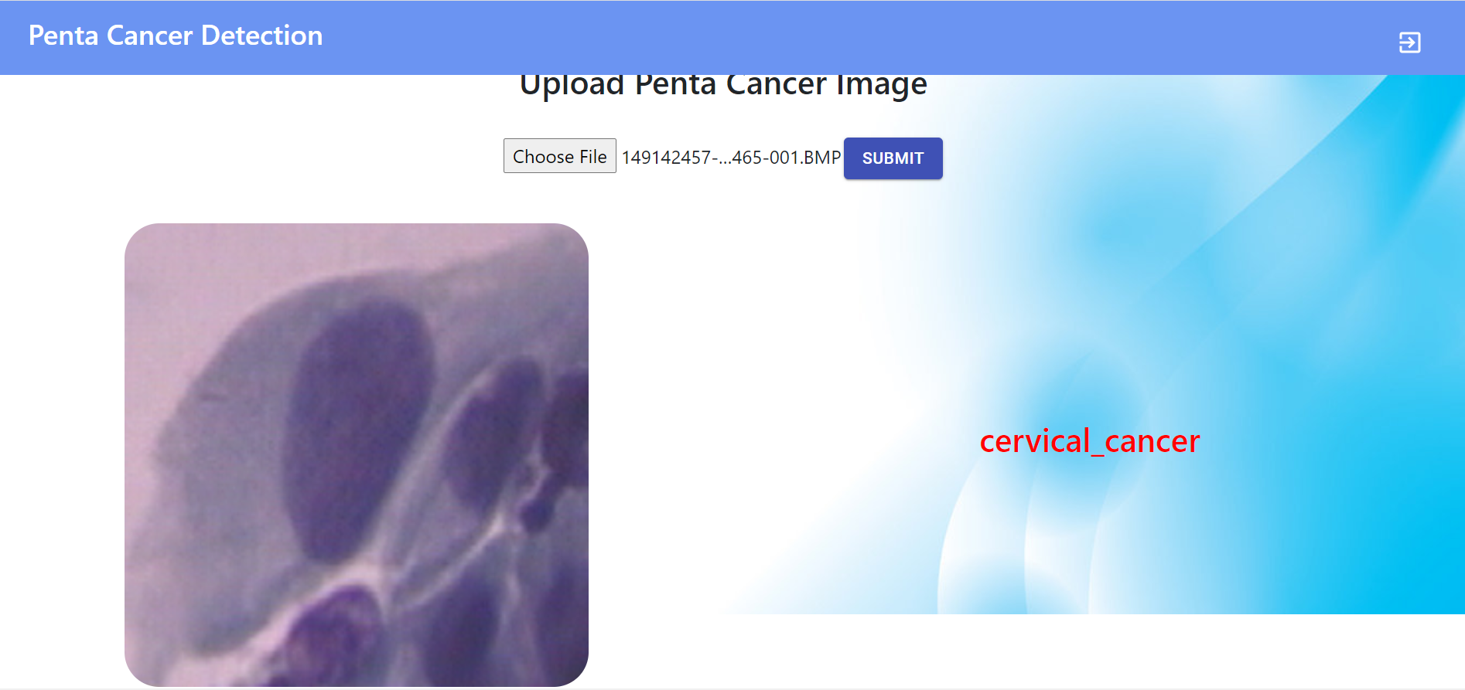
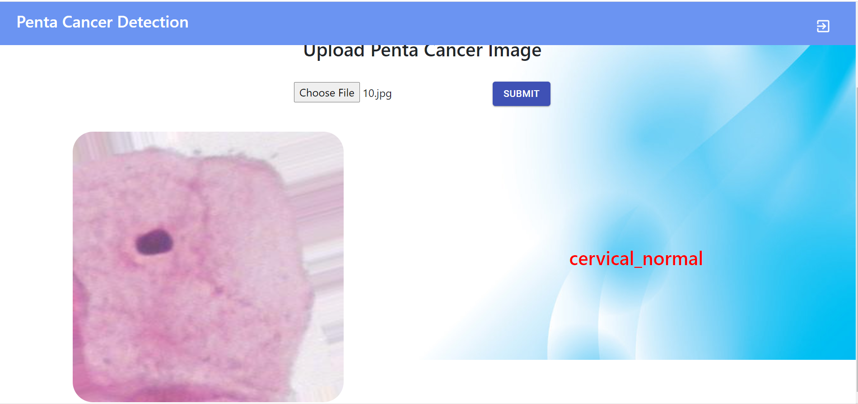
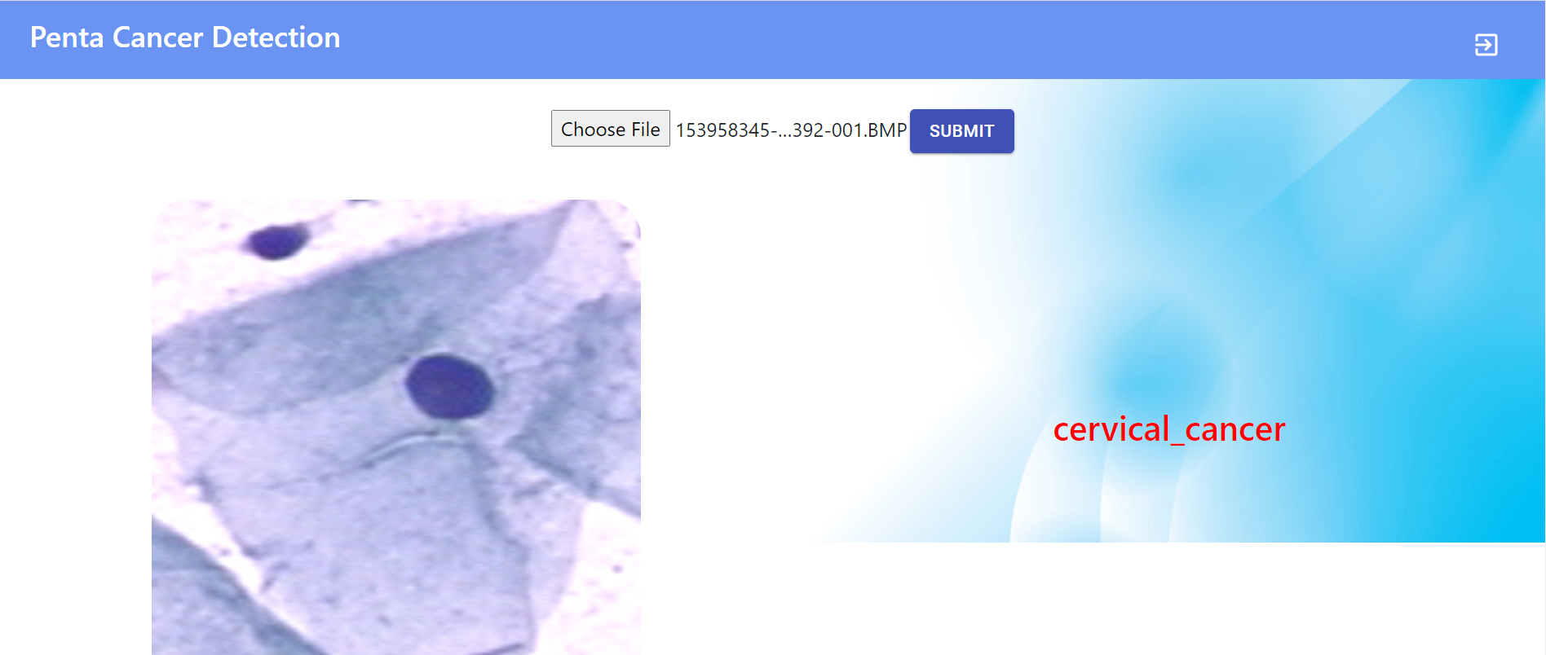
Cervix
True Positive True Negative
False Positive

Slide 34
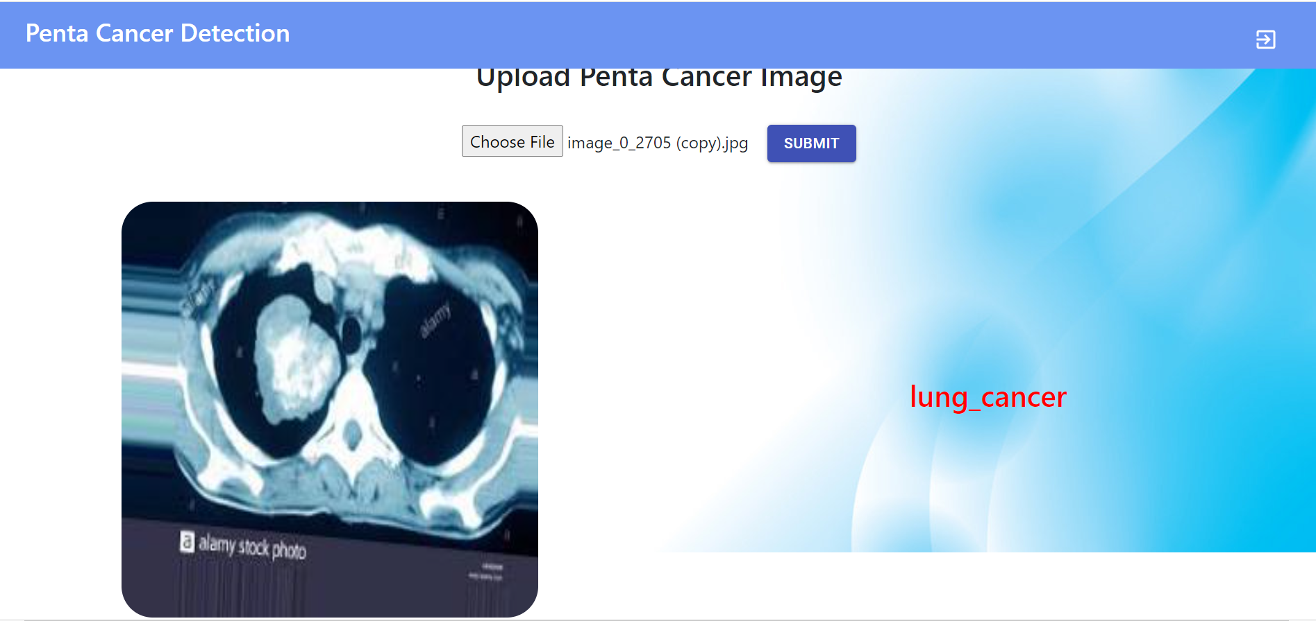
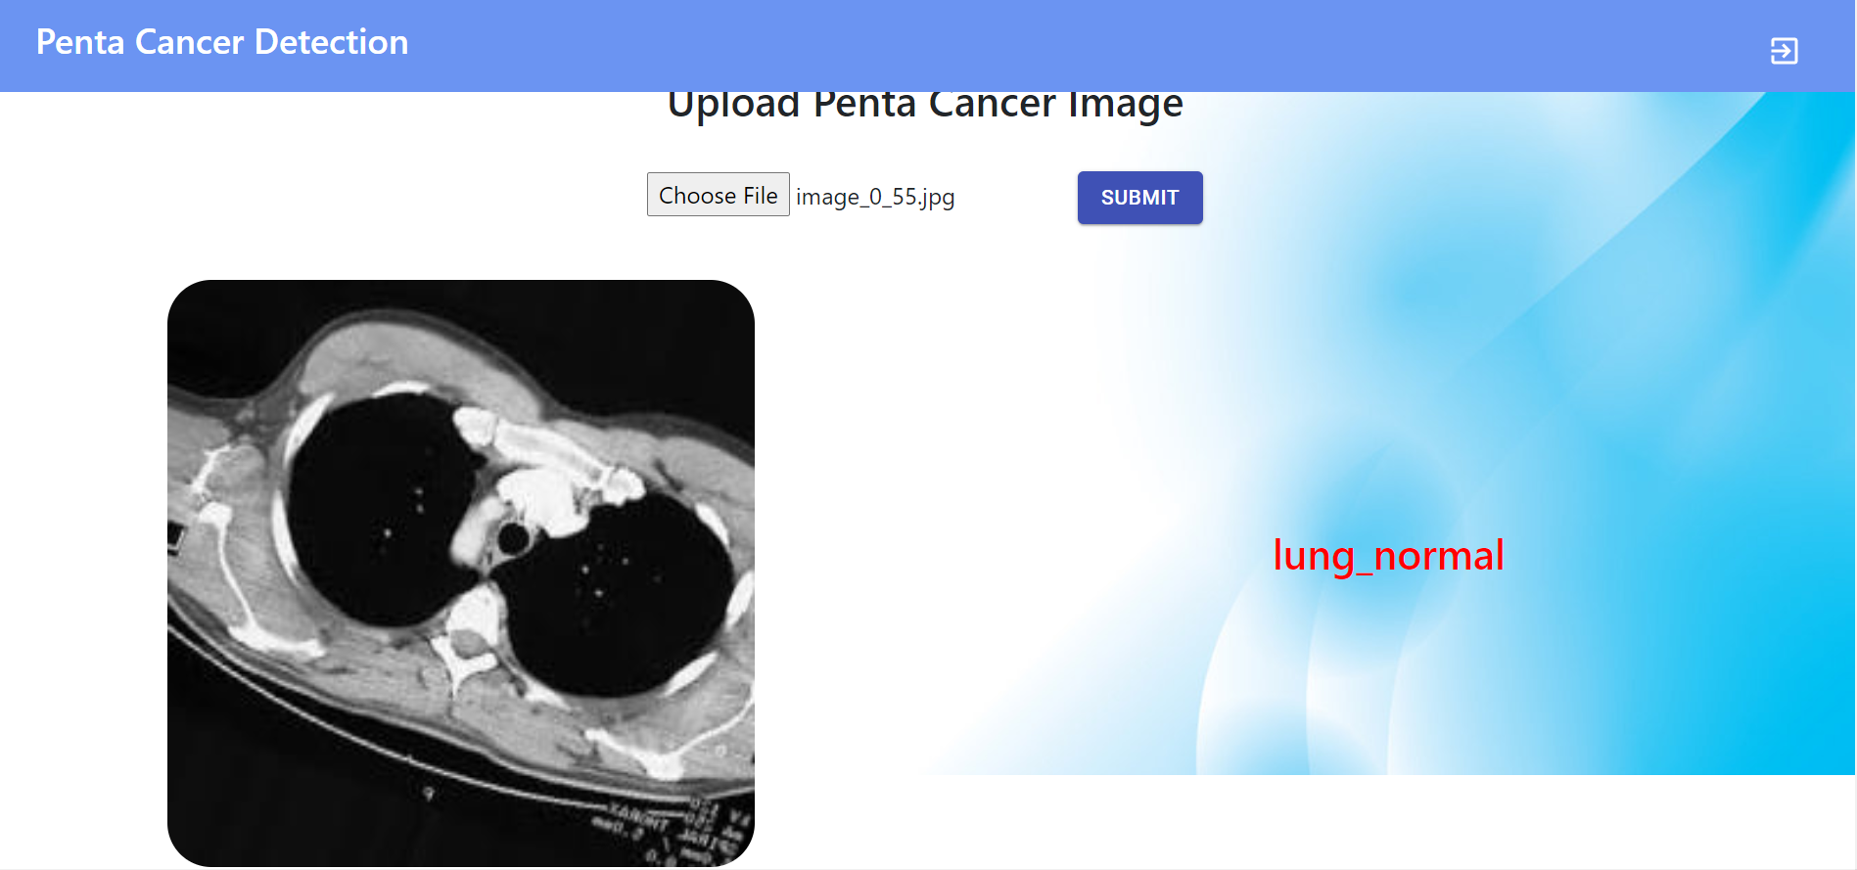
Lung
True positive True negative

Slide 35
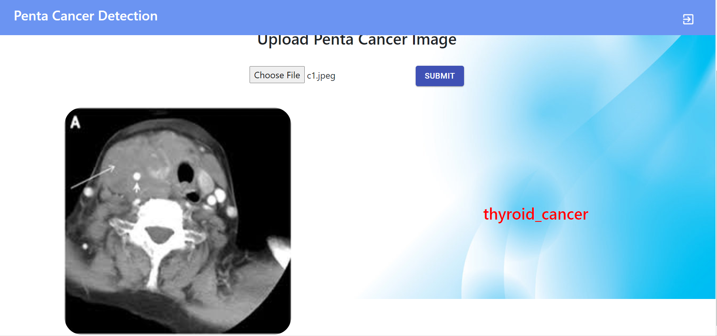
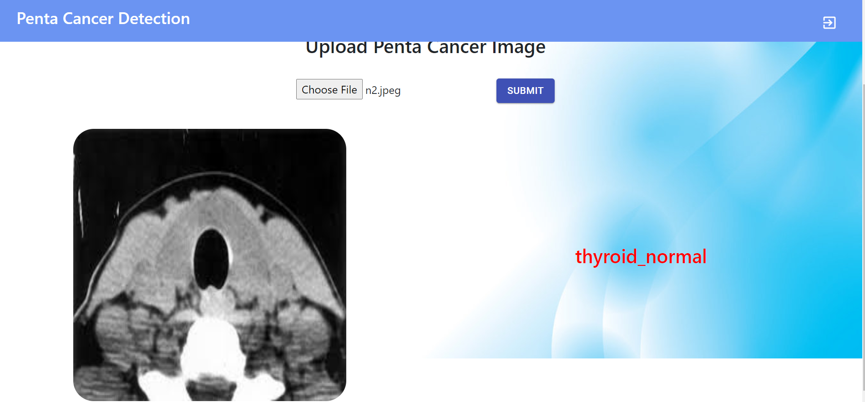
Thyroid
True Positive
True Negative

Slide 36
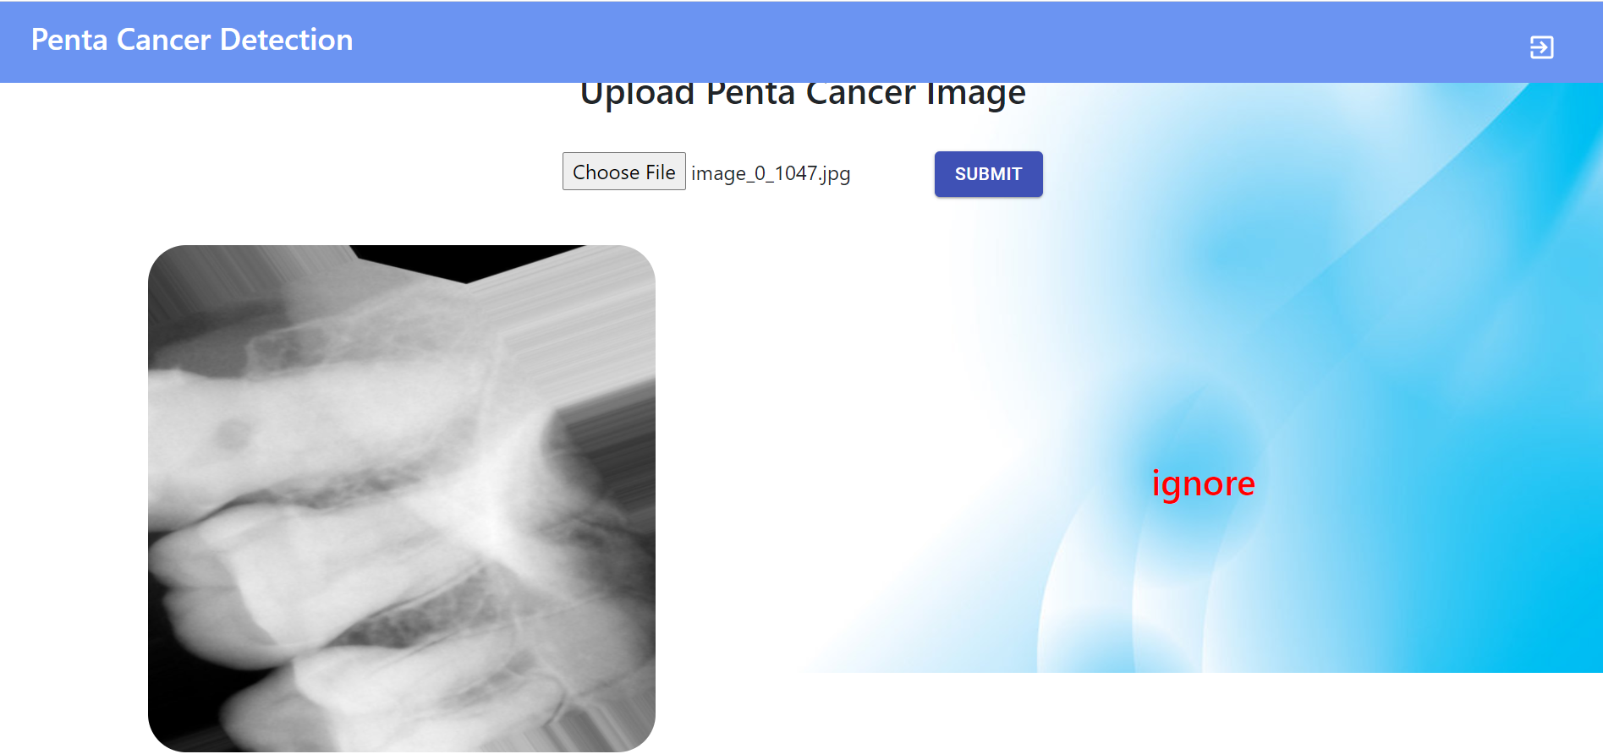
IGNORE CLASS

Slide 37
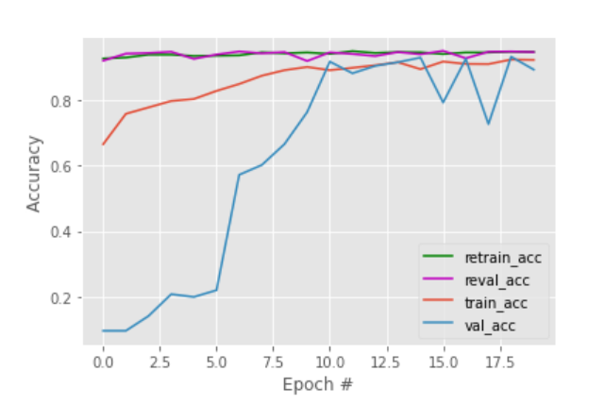
ACCURACY GRAPH

Slide 38
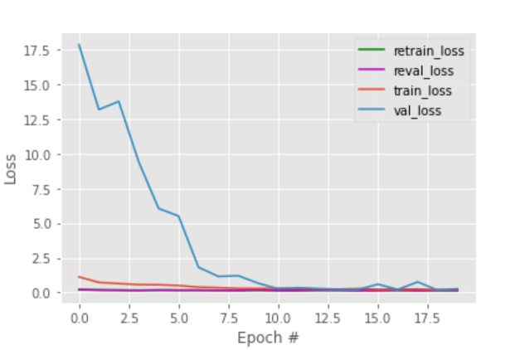
LOSS GRAPH

Slide 39
CONCLUSION & FUTURE WORKS
The project has been successfully implemented to detect the presence of five types of cancers and also determine its type.
Despite having used five separate datasets, one for each type of cancer, we haven’t extracted individual features from each separate cancer type as we have used a generalized algorithm for the same. For example, in the case of cervical cancer, one can extract and use the features from the nucleus in its histopathological image to perform the necessary training.
On a much broader scale,this method can be extended to find not just cancer,but also diagnose other anomalies that require scan images for diagnosis,generating a complete report of all the findings in a scan just like a report from a radiologist.

Slide 40
REFERENCES
[1] J. M. Anton-Rodriguez, P. Julyan, I. Djoukhadar, D. Russell, D. G. Evans, A. Jackson, and J. C. Matthews, “Comparison of a Standard Resolution PET-CT Scanner With an HRRT Brain Scanner for Imaging Small Tumors Within the Head,” IEEE Transactions on Radiation and Plasma Medical Sciences, vol. 3, no. 4, pp. 434–443, 2019.
[2] S. Azizi, S. Bayat, P. Yan, A. Tahmasebi, J. T. Kwak, S. Xu, B. Turkbey, P. Choyke, P. Pinto, B. Wood, P. Mousavi, and P. Abolmaesumi, “Deep Recurrent Neural Networks for Prostate Cancer Detection: Analysis of Temporal Enhanced Ultrasound,” IEEE Transactions on Medical Imaging, vol. 37, no. 12, pp. 2695–2703, 2018.
[3] T. Beaumont, P. Onoma, M. Rimlinger, D. Broggio, P. Caldeira Ideias, and D. Franck, “Age-Specific Experimental and Computational Calibration of Thyroid in vivo Monitoring,” IEEE Transactions on Radiation and Plasma Medical Sciences, vol. 3, no. 1, pp. 43–46, 2019.
[4] N. Emaminejad, W. Qian, Y. Guan, M. Tan, Y. Qiu, H. Liu, and B. Zheng, “Fusion of Quantitative Image and Genomic Biomarkers to Improve Prognosis Assessment of Early Stage Lung Cancer Patients,” IEEE Transactions on Biomedical Engineering, vol. 63, no. 5, pp. 1034–1043, 2016.
[5] H. Liu, H. Li, M. Habes, Y. Li, P. Boimel, J. Janopaul-Naylor, Y. Xiao, E. Ben-Josef, and Y. Fan, “Robust Collaborative Clustering of Subjects and Radiomic Features for Cancer Prognosis,” IEEE Transactions on Biomedical Engineering, vol. 67, no. 10, pp. 2735–2744, 2020.

Slide 41
[6] K. Mandal, R. Sarmah, and D. K. Bhattacharyya, “Biomarker Identification for Cancer Disease Using Biclustering Approach: An Empirical Study,” IEEE/ACM Transactions on Computational Biology and Bioinformatics, vol. 16, no. 2, pp. 490–509, 2019.
[7] A. Mirbeik-Sabzevari and N. Tavassolian, “Ultrawideband, Stable Normal and Cancer Skin Tissue Phantoms for Millimeter-Wave Skin Cancer Imaging,” IEEE Transactions on Biomedical Engineering, vol. 66, no. 1, pp. 176–186, 2019.
[8] A. A. Setio, F. Ciompi, G. Litjens, P. Gerke, C. Jacobs, S. J. van Riel, M. M. Wille, M. Naqibullah, C. I. Sanchez, and B. van Ginneken, “Pulmonary Nodule Detection in CT Images: False Positive Reduction Using Multi-View Convolutional Networks,” IEEE Transactions on Medical Imaging, vol. 35, no. 5, pp. 1160–1169, 2016.
[9] R. Singh, T. Ahmed, A. Kumar, A. K. Singh, A. K. Pandey, and S. K. Singh, “Imbalanced Breast Cancer Classification Using Transfer Learning,” IEEE/ACM Transactions on Computational Biology and Bioinformatics, pp. 1–1, 2020.
[10] Y. Wang, N. Wang, M. Xu, J. Yu, C. Qin, X. Luo, X. Yang, T. Wang, A. Li, and D. Ni, “Deeply-Supervised Networks With Threshold Loss for Cancer Detection in Automated Breast Ultrasound,” IEEE Transactions on Medical Imaging, vol. 39, no. 4, pp. 866–876, 2020.

